Slide 1
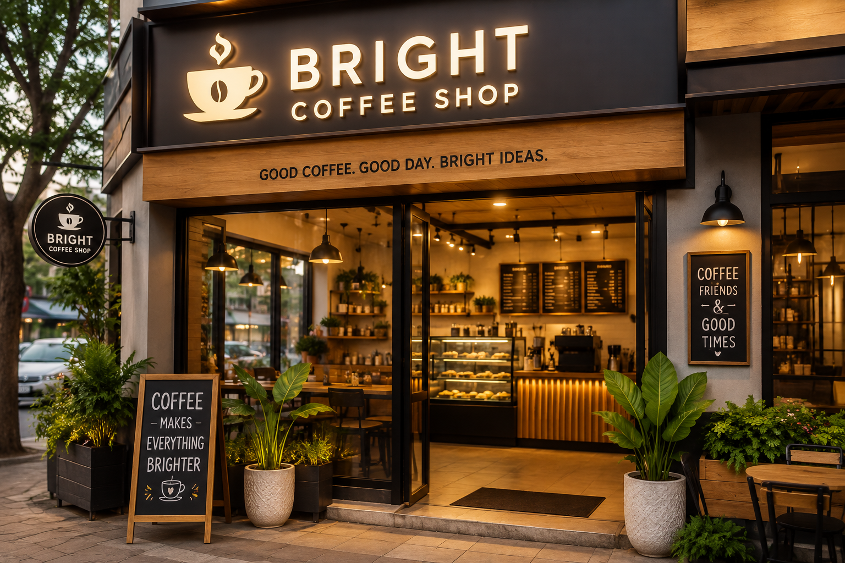
Bright Coffee Shop Sales Analysis
Business Intelligence Dashboard - BY Nonofo Sebako

Slide 2
Project Overview
Analyze sales performance, products, stores and customer behavior.
The Bright Coffee Shop Sales Analysis project focuses on analysing transactional sales data to uncover meaningful business insights. Using SQL and interactive dashboards, the project evaluates sales performance, customer purchasing behaviour, product performance, and store performance to support data-driven decision-making.
Objective
Transform raw transactional data into actionable business insights that help management improve sales performance and operational efficiency.

Slide 3
KPIs
Total Revenue, Transactions, Quantity, Avg Transaction, Best Product, Top Store
REVENUE
698.8K
UNIT SOLD
149.1K
Key Performance Indicators
The dashboard displays:
Total Revenue
Total Transactions
Total Quantity Sold
Average Transaction Value
Average Unit Price
Best Selling Product
Top Performing Store

Slide 4
Sales Trends
Monthly revenue and hourly sales analysis.
Monthly Revenue Trend
Analysis
Shows revenue performance over time.
Identifies seasonal trends.
Highlights the highest and lowest performing months.
Supports future sales forecasting.

Slide 5
Product & Store Performance
Top products, categories and store comparison.
Insights
Identify products generating the highest revenue.
Compare sales across product categories.
Determine which products should receive additional marketing support.

Slide 6
Insights & Recommendations
Peak hours, top products and business actions.
Recommendations
Based on the findings:
Increase stock for top-selling products.
Schedule more staff during peak business hours.
Promote low-selling products through targeted campaigns.
Focus marketing on high-performing stores.
Key Insights
From the analysis, several important findings emerged:
Certain products consistently generated the highest revenue.
A small number of products accounted for a significant share of total sales.
Sales varied by month, indicating seasonal trends.
Peak business hours were identified, helping to understand customer traffic patterns.
Recommendations
Based on the findings:
Increase stock for top-selling products.
Schedule more staff during peak business hours.
Promote low-selling products through targeted campaigns.
Focus marketing on high-performing stores.

